Slide 1
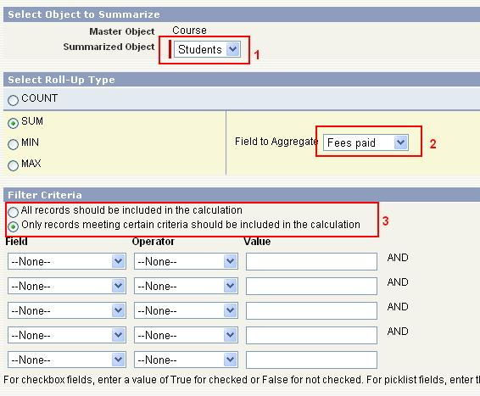
What is the Rollup Summary?
A read-only field that displays the sum, minimum, or maximum value of a field in a related list or the record count of all records listed in a related list.

